Slide 1
Unit 1: Algorithm Basics & Analysis - Recurrence
Name of the Faculty : Dr. Anurag Jain
Designation : Assistant Professor (SG)
Email id : anurag.jain@ddn.upes.ac.in

Slide 2
Recurrence
Implicit formula/Recurrence relation: When to generate the next term of the sequence, we are depending upon the previous term then it is called implicit formula or recurrence relation
e.g. T(n)=T(n-1)+n
Explicit formula: When to generate the next term of the sequence, we are not depending upon the previous term, through the knowledge of index of the term we can generate the term, then that formula is called explicit formula.
e.g. T(n)=3^{n}

Slide 3
Recurrence
Recurrences arise when an algorithm contains recursive calls to itself. Now to calculate the actual running time complexity of the algorithm, there is need to solve the recurrence relation.
Process of conversion of an implicit formula to explicit formula is called solution of recurrence relation.
Different methods of solving recurrence relation are as follows:
Iteration Method
Substitution Method
Recursion Tree Method
Master Theorem Method

Slide 4
Recurrence Solution by Iteration Method
Convert the recurrence into a summation and try to bound it using known series
Iterate the recurrence until the initial condition is reached.
Use back-substitution to express the recurrence in terms of n and the initial (boundary) condition.

Slide 5
Recurrence Solution by Iteration Method Example 1
T(n) = c + T(n/2) Assume n = 2^{k} Value of T(1) is given.
T(n) = c + T(n/2) T(n/2) = c + T(n/4)
T(n) = c + c + T(n/4) T(n/4) = c + T(n/8)
T(n) = c + c + c + T(n/8) T(n/8) = c + T(n/16)
T(n) = c + c + … + c + T(1)
= clgn + T(1)
= Θ(lgn)

Slide 6
Recurrence Solution by Iteration Method – Example 2
T(n) = n + 2T(n/2) Assume n = 2^{k} T(1) is given
T(n) = n + 2T(n/2) T(n/2) = n/2 + 2T(n/4)
T(n) = n + 2(n/2 + 2T(n/4)) T(n/4) = n/4 + 2T(n/8)
T(n) = n + n + 4(n/4 + 2T(n/8)) T(n/8) = n/8 + 2T(n/16)
T(n) = n + n +n +8 T(n/8)
= in+2^{i}T(n/2^{i})
= kn+2^{k}T(n/2^{k})
= nlgn+nT(1)
= Θ(nlgn)

Slide 7
Recurrence Solution by Substitution Method
Guess the solution.
e.g. Let T(n)=O(g(n)) is the solution guessed for given recurrence to be solved
Use the mathematical induction to find the boundary conditions and show that the guess is correct.
Induction Goal: T(n) ≤ d g(n), for some d > 0 and n ≥ n₀
Induction Hypothesis: e.g. T(k) ≤ d g(k), for some d > 0 and for all k<n and n ≥ n₀
Prove the induction goal
Use the induction hypothesis to find some values of the constants d and n₀ for which the induction goal holds

Slide 8
Recurrence Solution by Substitution Method – Example 1
Solve T(n)=T(n/2) +c
Guess the solution. T(n)=O(lg(n))
Induction Goal: T(n) ≤ d*lg(n), for some d > 0 and n ≥ n₀
Induction Hypothesis: T(n/2) ≤ d*lg(n/2)
Prove the induction goal
T(n) = T(n/2) + c
T(n) ≤ d*lg(n/2) + c
T(n) ≤ d*lg(n)-d*lg₂(2) + c
T(n) ≤ d*lg(n)- d+ c (1)
d*lg(n)- d+ c ≤ d*lg(n) (2)
From (1) & (2) it can be concluded that
T(n) ≤ d*lg(n) holds when - d+ c ≤ 0 i.e. - d ≤ -c which implies d ≥ c
So induction goal holds when d ≥ c and n ≥ 2

Slide 9
Recurrence Solution by Substitution Method – Example 2
Solve T(n)=T(n-1) +n
Guess the solution. T(n)=O(n²)
Induction Goal: T(n) ≤ c*n², for some c > 0 and n ≥ n₀
Induction Hypothesis: T(n-1) ≤ c*(n-1)²
Prove the induction goal
T(n) = T(n-1) + n
T(n) ≤ c*(n-1)² + n
T(n) ≤ cn² –(2nc -c –n) (1)
cn² –(2nc -c –n) ≤ cn² (2)
From (1) & (2) it can be concluded that
T(n) ≤ cn² holds when 2nc -c –n ≥ 0 ⇔ c ≥ n/(2n-1) ⇔ c ≥ 1/(2 – 1/n)
So induction goal holds when c ≥ 1 and n ≥ 1

Slide 10
Recurrence Solution by Substitution Method – Example 3
Solve T(n)=2T(n/2) +n
Guess the solution. T(n)=O(nlgn)
Induction Goal: T(n) ≤ cnlgn, for some c > 0 and n ≥ n₀
Induction Hypothesis: T(n/2) ≤ c(n/2)(lg(n/2))
Prove the induction goal
T(n) = 2T(n/2) + n
T(n) ≤ 2c(n/2)(lg(n/2)) + n
T(n) ≤ cnlgn – cn +n (1)
cnlgn – cn +n ≤ cnlgn (2)
From (1) & (2) it can be concluded that
T(n) ≤ cnlgn holds when – cn +n ≤ 0 ⇒ – cn ≤ -n ⇒ c ≥ 1
So induction goal holds when c ≥ 1 and n ≥ 1

Slide 11
Recurrence Solution by Substitution Method – Example 4
Change of variable method
Solve T(n)=2T( )+lgn
Rename: m = lgn ⇒ n = 2^{m}
T (2^{m}) = 2T(2^{m/2}) + m
Rename: S(m) = T(2^{m})
S(m) = 2S(m/2) + m and this has solution S(m)= O(mlgm) as done in example 3
T(n) = T(2^{m}) = S(m) = O(mlgm)=O((lgn)(lglgn))
Some more examples: T(n)=2T( )+1 by substitution method
T(n)=T(n-1)+n⁴ by iteration method

Slide 12
Recurrence Solution by Recursion Tree Method
This method is a pictorial representation of iteration method.
It uses tree to solve the problem. Nodes are expanded at each level.
Each node represents the cost incurred at various levels of recursion.
Sum up the costs of all levels.
Second term in the recurrence is considered as root.
f(n)=af(n/b) f(n/b)=af(n/b²)
f(n)=a²f(n/b²)

Slide 13
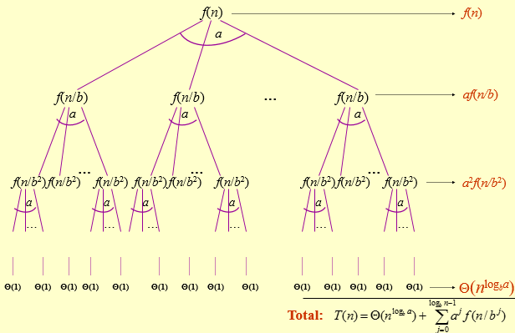
Recurrence Solution by Recursion Tree Method

Slide 14
Recurrence Solution by Iteration & Recursion Tree
W(n)=2W(n/2) + n²
W(n)=2(2W(n/4) + n²/4) + n²
W(n)=2² W(n/2²) + n²/2+ n²
W(n)=2² (2W(n/8) +n²/16) + n²/2+ n²
W(n)=2³ W(n/2³) + n²/2²+ n²/2¹+ n²/2⁰
W(n)=2³(2W(n/16) +n²/64) + n²/2²+ n²/2¹+ n²/2⁰
W(n)=2⁴ W(n/2⁴) +n²/2³+ n²/2²+ n²/2¹+ n²/2⁰
.
.
.
.
.
W(n)= 2^{k} W(n/2^{k}) + n²/2^{k-1}+……+ n²/2¹+ n²/2⁰
W(n)= 2^{k} W(n/2^{k}) + n²(1/2^{k-1}+……+ 1/2¹+ 1/2⁰)
W(n)= nW(1) + n²2(1-(1/2)^{k})
W(n) = O(n²)
W(n/2) = 2W(n/4) + n²/4
W(n/4) = 2W(n/8) +n²/16
W(n/8) = 2W(n/16) +n²/64
Now n = 2^{k}
K = lgn

Slide 15
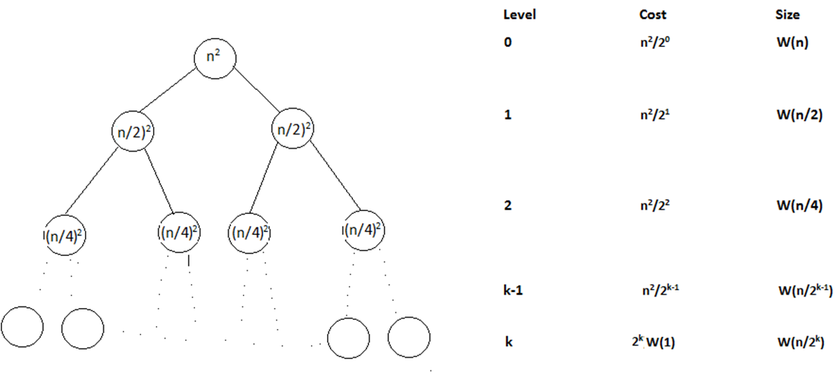
Recurrence Solution by Iteration & Recursion Tree

Slide 16
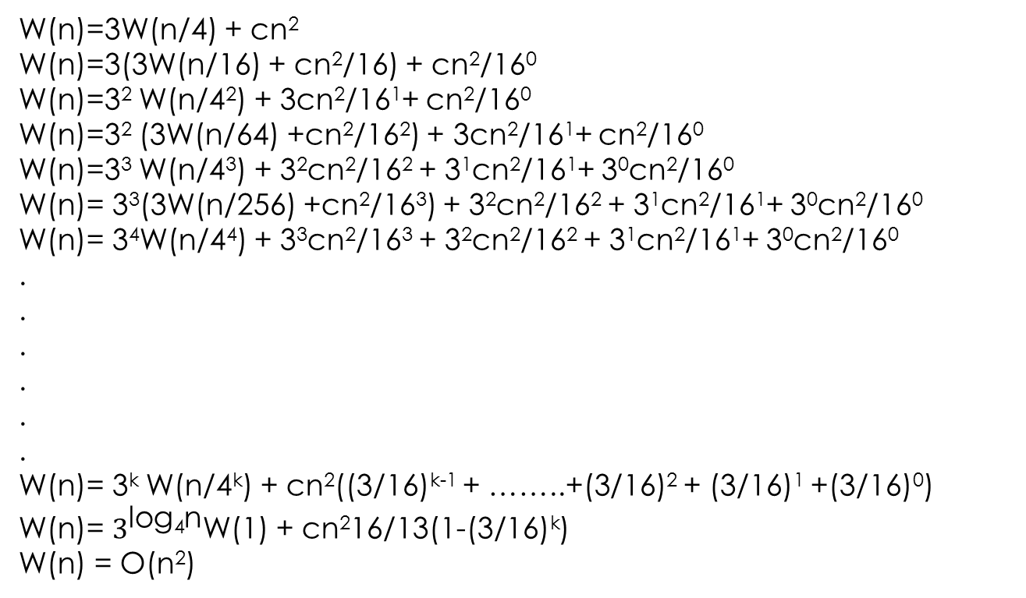
Recurrence Solution by Iteration & Recursion Tree
W(n)=3W(n/4) + cn²
W(n)=3(3W(n/16) + cn²/16) + cn²/16⁰
W(n)=3² W(n/4²) + 3cn²/16¹+ cn²/16⁰
W(n)=3² (3W(n/64) +cn²/16²) + 3cn²/16¹+ cn²/16⁰
W(n)=3³ W(n/4³) + 3²cn²/16² + 3¹cn²/16¹+ 3⁰cn²/16⁰
W(n)= 3³(3W(n/256) +cn²/16³) + 3²cn²/16² + 3¹cn²/16¹+ 3⁰cn²/16⁰
W(n)= 3⁴W(n/4⁴) + 3³cn²/16³ + 3²cn²/16² + 3¹cn²/16¹+ 3⁰cn²/16⁰
.
.
.
.
.
.
W(n)= 3^{k} W(n/4^{k}) + cn²((3/16)^{k-1} + ……..+(3/16)² + (3/16)¹ +(3/16)⁰)
W(n)= $3^{\text{log}\text{4}\text{n}}$W(1) + cn²16/13(1-(3/16)^{k})
W(n) = O(n²)
W(n/4) = 3W(n/16) + cn²/16
W(n/16) = 3W(n/64) +cn²/16²
W(n/64) = 3W(n/256) +cn²/16³
Now n = 4^{k}
K = log₄n

Slide 17
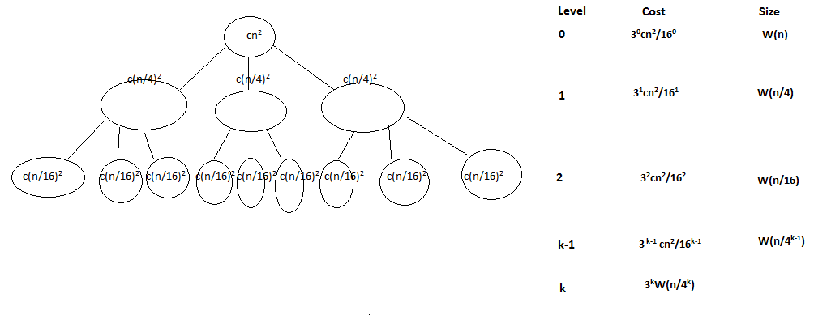
Recurrence Solution by Iteration & Recursion Tree

Slide 18
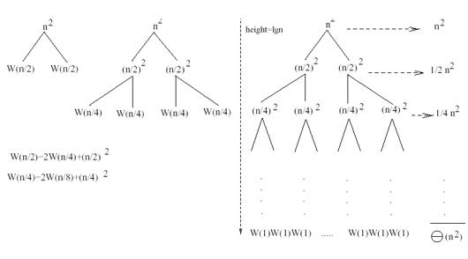
Recurrence Solution by Recursion Tree Method – Example1
W(n) = 2W(n/2) + n²

Slide 19
Recurrence Solution by Recursion Tree Method – Example1
W(n) = 2W(n/2) + n²
Sub problem size at level i is: n/2^{i}
Sub problem size hits 1 when 1 = n/2^{i} ⇒ i = lgn
Cost of the problem at level i = (n)² /2^{i}
No. of nodes at level i = 2^{i}
Total cost:
⇒ W(n) = O(n²)

Slide 20
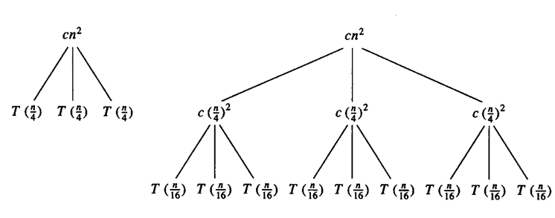
Recurrence Solution by Recursion Tree Method – Example 2
T(n) = 3T(n/4) + cn²

Slide 21
Recurrence Solution by Recursion Tree Method – Example2
T(n) = 3T(n/4) + cn²
Sub problem size at level i is: n/4^{i}
Sub problem size hits 1 when 1 = n/4^{i} ⇒ i = log₄n
Cost of a node at level i = c(n/4^{i})²
Number of nodes at level i = 3^{i} ⇒ last level has 3^{log}₄^{n} = n^{log}₄³ nodes
Total cost:
⇒ T(n) = O(n²)

Slide 22
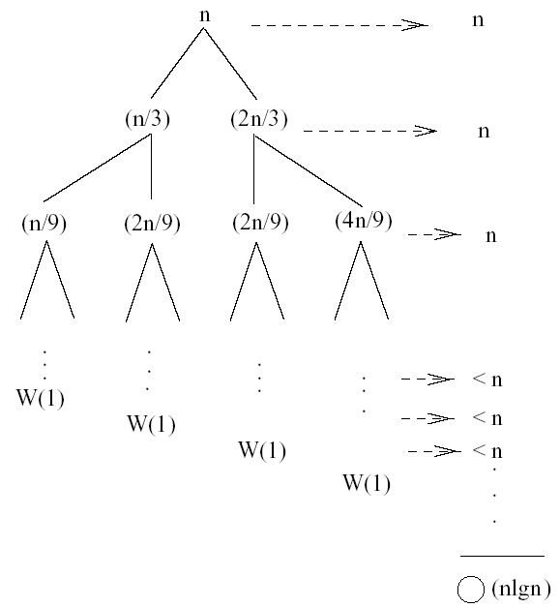
Recurrence Solution by Recursion Tree Method – Example 3
W(n) = W(n/3) + W(2n/3) + n

Slide 23
Recurrence Solution by Recursion Tree Method – Example 3
W(n) = W(n/3) + W(2n/3) + n
The longest path from the root to a leaf is:
n → (2/3)n → (2/3)² n → … → 1
Sub-problem size hits 1 when 1 = (2/3)^{i}n ⇔ i=log_{3/2}n
Cost of the problem at level i = n
Total cost:
⇒ W(n) = O(nlgn)

Slide 24
Recurrence Solution by Master Theorem Method
If an expression is of the following form:
T(n)=aT(n/b) +f(n) where
a≥1
b>1
f(n)>0
n/b may not be an integer, but we ignore floors and ceilings
then we can simplify the expression using Master Theorem method.
Problem is divided into a sub problems each of size n/b where a and b are positive constants.

Slide 25
Recurrence Solution by Master Theorem Method
Calculate n^{log}_{b}ª (n raise to the power log of a to the base b)
Now compare f(n) with n^{log}_{b}ª and express the T(n) asymptotically based on the following conditions:
Case 1: if f(n) = O(n^{log}_{b}^{a -ε}) for some ε > 0, then: T(n) = Θ(n^{log}_{b}ª)
Case 2: if f(n) = Θ(n^{log}_{b}ª ), then: T(n) = Θ(n^{log}_{b}ª lgn)
Case 3: if f(n) = Ω(n^{log}_{b}^{a +ε}) for some ε > 0, and if a*f(n/b) ≤ c*f(n) for some c < 1 and all sufficiently large n, then: T(n) = Θ(f(n))
regularity condition

Slide 26
Recurrence Solution by Master Theorem Example 1
T(n) = 2T(n/2) + n
a = 2, b = 2, log₂2 = 1
Compare n^{log}₂² with f(n) = n
⇒ f(n) = Θ(n) ⇒ Case 2
⇒ T(n) = Θ(nlgn)

Slide 27
Recurrence Solution by Master Theorem Example 2
T(n) = 2T(n/2) + n²
a = 2, b = 2, log₂2 = 1
Compare n with f(n) = n²
⇒ f(n) = Ω(n^{1+ε}) Case 3 ⇒ verify regularity cond.
a f(n/b) ≤ c f(n)
⇔ 2 n²/4 ≤ c n² ⇒ c = ½ is a solution (c<1)
⇒ T(n) = Θ(n²)

Slide 28
Recurrence Solution by Master Theorem Example 3
T(n) = 2T(n/2) + n^{1/2}
a = 2, b = 2, log₂2 = 1
Compare n with f(n) = n^{1/2}
⇒ f(n) = O(n^{1-ε}) Case 1
⇒ T(n) = Θ(n)

Slide 29
Recurrence Solution by Master Theorem Example 4
T(n) = 3T(n/4) + nlgn
a = 3, b = 4, log₄3 = 0.793
Compare n^{0.793} with f(n) = nlgn
f(n) = Ω(n^{log}₄^{3+ε}) Case 3
Check regularity condition:
3∗(n/4)lg(n/4) ≤ (3/4)nlgn = c ∗f(n), c=3/4
⇒T(n) = Θ(nlgn)

Slide 30
Recurrence Solution by Master Theorem Example 5
T(n) = 16T(n/4)+n
a = 16, b = 4, n^{logba} = n^{log416} = n².
f(n) = n = O(n^{logba-ε}) = O(n^{2-ε} ), where ε = 1 ⇒ Case 1.
Hence, T(n) = Θ(n^{logba} ) = Θ(n²).
T(n) = T(3n/7) + 1
a = 1, b=7/3, and n^{logba} = n^{log 7/3 1} = n⁰ = 1
f(n) = 1 = Θ(n^{logba}) ⇒ Case 2.
Therefore, T(n) = Θ(n^{logba} lg n) = Θ(lg n)

